Slide 1






FAKE NEWS DETECTION USING MACHINE LEARNING

Slide 2
Contents
Abstract
Problem Statement
Architecture
Software Requirements
Steps Involved
Algorithms Used
Accuracy of Algorithms
Dataset Visualization
Comparing Accuracy
Web Application
Conclusion

Slide 3


Abstract
Fake news detection refers to the process of identifying and classifying news articles, reports, or other forms of information as either genuine or fabricated with the intent to deceive or mislead readers.
As the world is getting digitalize, there are numerous number of platforms to get the information. People are getting confused to know whether the news is real or fake.
The proliferation of fake news poses several significant disadvantages and threats to individuals, society, and the integrity of information dissemination.

Slide 4
Problem Statement
The proliferation of fake news in online platforms presents a significant challenge to society, undermining trust in information sources, distorting public discourse, and posing threats to democratic processes.
To address this issue, there is a critical need for effective fake news detection systems leveraging machine learning (ML) techniques. To solve this problem, there are certain steps to be involved.
The challenge lies in developing effective methods to detect and combat fake news in real-time.

Slide 5
Architecture
Data Collection
Pre Processing
Visualization
Splitting Data
Logistic Regression
Compare Accuracy
Train
Test
Decision Tree
Random Forest
Navie Bayes
Passive Aggressive
Model Building
Save Model And Classify News
SVM

Slide 6
Software Requirements
Environment: VS Code
Libraries:
PANDAS
NLTK
MATPLOTLIB
SEABORN
SKLEARN
JOBLIB
STREAMLIT

Slide 7
Steps Involved
Data Collection
Data Pre Processing
Visualization
Splitting Data
Training Data
Testing Data
Modelling
Comparing Accuracy
Save the Model

Slide 8
Algorithms Used
Logistic Regression
Decision Tree
Random Forest
Naïve Bayes
Passive Aggressive Classifier
Support Vector Machine (SVM)

Slide 9
Accuracy of Algorithms
NAME OF THE MODEL | ACCURACY
LOGISTIC REGRESSION | 92.479339
DECISION TREE | 79.33884
RANDOM FOREST | 89.173554
NAÏVE BAYES | 82.727273
PASSIVE AGGRESSIVE | 93.801653
SUPPORT VECTOR MACHINE | 93.966942

Slide 10
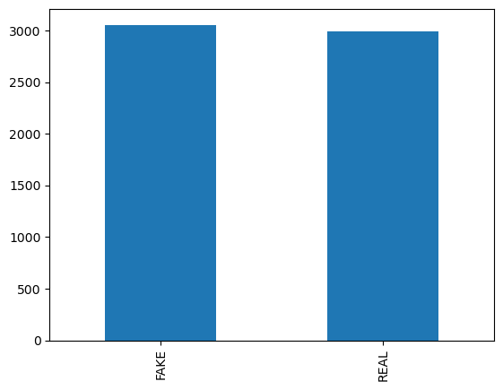
Visualization of Dataset

Slide 11
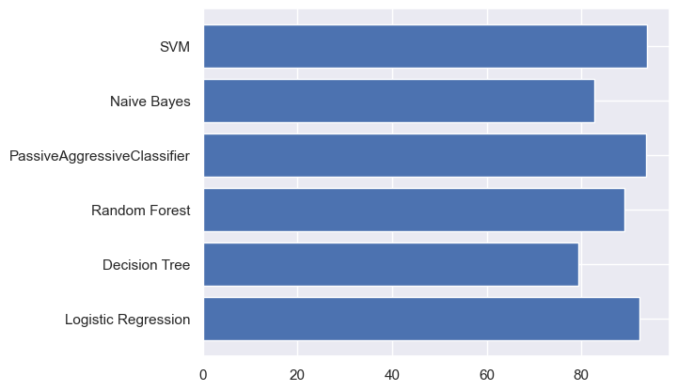
Comparing Accuracy
SVM got the highest accuracy of 93.9% for our dataset

Slide 12

Web Application

Slide 13
Conclusion
Finally we can conclude that by using different machine learning algorithms we have saved the one model which gives the better accuracy than other models. The saved model is the SVM which is good when compared to other models. And finally after saving the model the we designed the streamlit model to predict whether the given news is fake or real.

Slide 14
Thanks!☺
Submitted By:
Ande SaiLakshmi
Boyina Lavanya
Durga Bommareddy
Garikipati Bandhavi

